Slide 1
What is ACOEM?
A short history and current description of the College

Slide 2
Slide Credits
Dr. Tee Guidotti
Dr. Robert Orford
Additional material from ACOEM website

Slide 3
BLUF
“ACOEM is the pre-eminent physician-led organization that champions the health of workers, safety of workplaces, and quality of environments.”
https://acoem.org/About-ACOEM
Notes:
Now let me explain a little about the history and development of ACOEM, and convince you of why this statement is true.

Slide 4
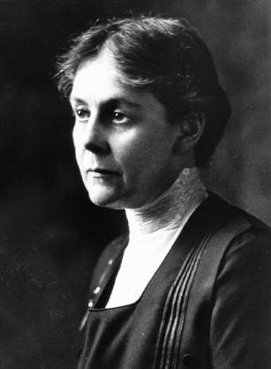
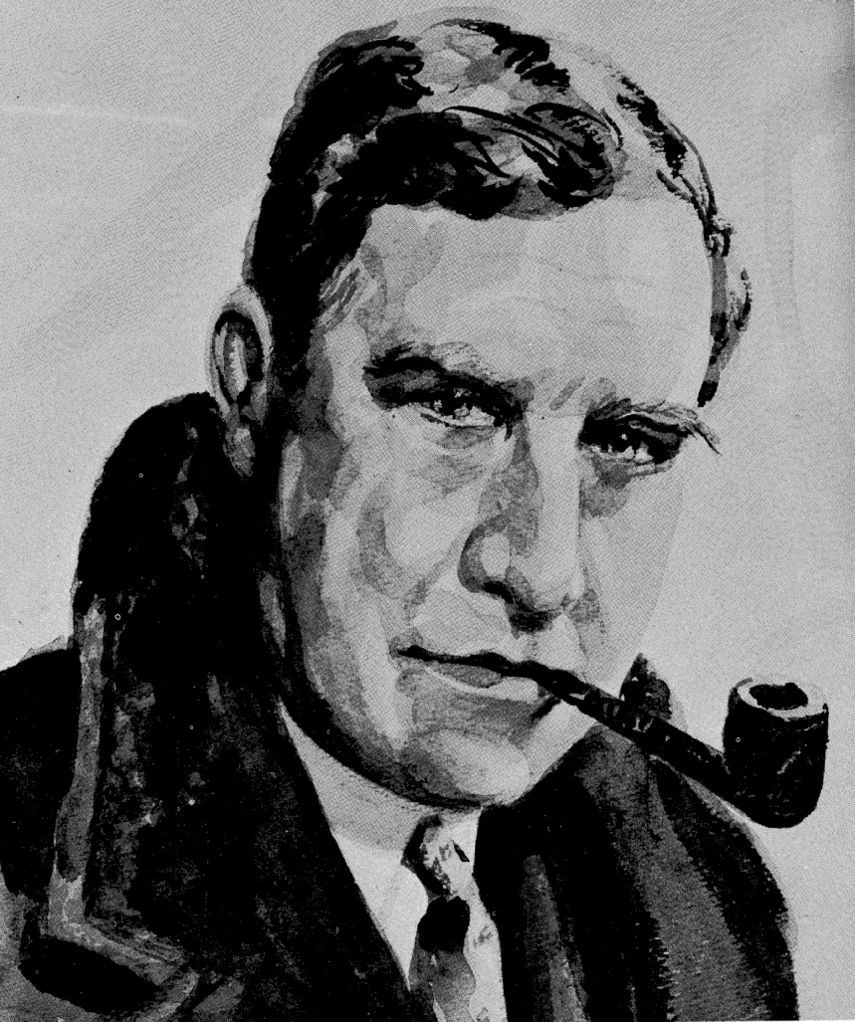
Establishing Foundations
Alice Hamilton
Harry Mock

Slide 5
Foundations of OEM in the US
Alice Hamilton
Harry Mock
Scientific (toxicological) basis
Invented US regulatory toxicology
Seminal textbook:
Industrial Toxicology
First woman professor at Harvard
Most of career in academics or government service
“No young doctor nowadays can hope for work as exciting and rewarding.”
Clinical basis, especially FFD
“Invented” worksite health promotion and education
Seminal textbook:
Industrial Medicine & Surgery
First OEM teaching clinic in North America (Loyola, Chicago)
Most of career at Sears Roebuck
“Physical qualifications, plus occupational qualifications, equal a job.”

Slide 6
ACOEM Historical Timeline
Year | Organization Name
1916 | American Association of Industrial Physicians and Surgeons (AAIPS)
1951 | AAIPS → Industrial Medical Association (IMA)
1974 | IMA → American Occupational Medicine Association (AOMA) + American Academy of Occupational Medicine (AAOM)
1988 | AOMA + AAOM → American College of Occupational Medicine (ACOM)
1992 | ACOM → American College of Occupational and Environmental Medicine (ACOEM)
Notes:
What led to creation of the American Academy of Occupational Medicine?
Concept: 1) promote academic rigor and research, 2) upgrade meetings, 3) physicians-only venue
Somewhat controversial; a small group proceeded anyway
Intended to “higher” tier within Association, not schismatic
Led to the fall meeting, with more academic content

Slide 7
The Organization Evolves
Original AAIPS meetings - small, typical medical society functions
Attended by Hamilton, Mock, etc.
American Occupational Health Conference (AOHC) became an ACOEM-led, interprofessional enterprise
Industrial hygienists (until 1997)
OH nurses (until 2005)
Virtually all-physician from 2005 (until recently)

Slide 8
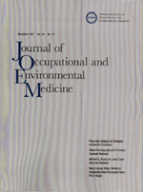
What Constitutes a Medical Specialty?
Board certification – e.g., ABPM
Professional organizations – e.g., ACOEM
International networks - e.g., ICOH
Centers of excellence – e.g.,
NIOSH intramural and extramural research
ERCs funded by NIOSH
Military programs
Journals – e.g., JOEM, OEM, AJIM, SJWEH, etc.
Notes:
OEM also has a Federal presence: CDC/NIOSH, OSHA, ATSDR, NIEHS

Slide 9
Board Certification
Predecessor certification mechanism in US Military, WWII
Antagonism: AMA, APHA, both in competition with IMA
Board Certification (1949)
American Board of Public Health & Preventive Medicine established in 1948
“American Board of Occupational Medicine” established in 1949
Initial 4-year training plan
Joined with “PH/PM” to form renamed ABPM in 1949
Compromise on certification requirements led to 3-year program
ABMS authorized board certification in 1955
Notes:
3-year program is challenging today

Slide 10
OM in the 1950’s
“Corporate practice of medicine” perceived as threat by AMA
OM not fee for service – therefore suspect
Structure of OM seen as conflict of interest
General practice “claimed” OM
Conflict over “industrial medicine” within AMA
Concern with providing primary care at worksite
AMA set up parallel Councils in OM, PH
Competed with IMA, APHA for dominance
Also tied into battle against national health insurance
ABPM certification partly a response to upgrade OM’s standing
Conflict with APHA, PM/PH impacted plan
Forced reduction in training time and more modest objectives

Slide 11
Recent History
Dominant groups change, but diversity always present
1970’s: corporate medical directors
1980’s: private practitioners
1990’s: academic and private practitioners
2000’s: consultants, academics, clinic practitioners
ACOEM as an organization
“Big tent” rather than single interest group
Network for engagement
More difficult task than most medical societies
Better able to navigate in many ways
Prevention much harder to sustain than treatment

Slide 12
Practice Activities of ACOEM Members
Administration 18%
Clinical Practice 65%
Consulting 12%
Research 2%
Teaching 2%
Other 1%
Notes:
Slide Title: Practice Activities of ACOEM Members

Slide 13
ACOEM Vision
Strengthening communities and workplaces by ensuring worker health, safety, and well-being and fostering a healthful environment.
Notes:
Slide Title: ACOEM Vision

Slide 14
ACOEM Mission
Provide leadership to promote optimal health and safety of workers, workplaces, and environments through:
Education of profession and public
Enhancing quality of OEM practice
Guiding workplace and public policy
Advancing the field of OEM (advocacy and research)
Notes:
Slide Title: ACOEM Mission

Slide 15
ACOEM’s Organizational Goals and Strategies (2020-2023)
GOAL 1: INCREASE MEMBER ENGAGEMENT AND VALUE IN ACOEM MEMBERSHIP
Expand educational offerings, including CME
Provide tools for professional development by career stage
Conduct regular member needs assessments to improve member experience
Increase opportunities for volunteer involvement to all member types through a transparent application process
Notes:
Slide Title: ACOEM’s Strategic Goals

Slide 16
ACOEM’s Organizational Goals and Strategies (2020-2023)
GOAL 2: INCREASE IMPACT OF ACOEM AND ORGANIZATIONAL EFFECTIVENESS
Develop and provide competency based ACOEM tools and resources
Enhance communication and collaboration between ACOEM Leadership, ACOEM Sections, and Component Societies
Streamline governance entities to improve organizational efficiency
Notes:
Slide Title: ACOEM’s Strategic Goals

Slide 17
ACOEM’s Organizational Goals and Strategies (2020-2023)
GOAL 3: COMMUNICATE VALUE AND INCREASE VISIBILITY OF OEM AND ACOEM
Expand outreach, education, promotion of OEM to medical students, residents, non-OEM mid-career physicians, other health/allied professionals
Establish new communication vehicles and educational opportunities for both internal and external audiences
Identify, engage, and explore partnership opportunities with public audiences who can be educated about the value of OEM
Increase social media presence and engagement
Partner with other medical societies/organizations, develop targeted alliances
Notes:
Slide Title: ACOEM’s Strategic Goals

Slide 18
ACOEM’s Organizational Goals and Strategies (2020-2023)
GOAL 4: ADVANCE THE OEM BODY OF KNOWLEDGE
Offer new opportunities to showcase and support evidence-based medicine and cutting-edge content
Increase collaboration and diversify panels for the development of guidelines, position papers, and educational offerings
Stimulate research and foster collaboration among researchers and clinicians
Identify knowledge gaps and future research directions
Notes:
Slide Title: ACOEM’s Strategic Goals

Slide 19
ACOEM’s Organizational Goals and Strategies (2020-2023)
GOAL 5: IMPROVE THE VIABILITY AND SUSTAINABILITY OF ACOEM
Identify and develop plans to retain members, attract new members
Expand product offerings and enhance access to education to all members of the healthcare and occupational health team
Increase content-driven revenue opportunities consistent with the ACOEM mission
Identify and develop emerging leaders and prospective faculty while recognizing those who have made significant contributions
Strengthen and support the Occupational and Environmental Health Foundation (OEHF)
Notes:
Slide Title: ACOEM’s Strategic Goals

Slide 20
ACOEM Membership
Categories
Benefits Include
Active (non-resident MDs/DOs)
Associate (non-physician)
Resident
Retired physician
Student
JOEM
MDGuidelines
OEM Explore (Career Exploration Platform) – New
Education (AOHC, webinars, etc.)
Leadership opportunities

Slide 21
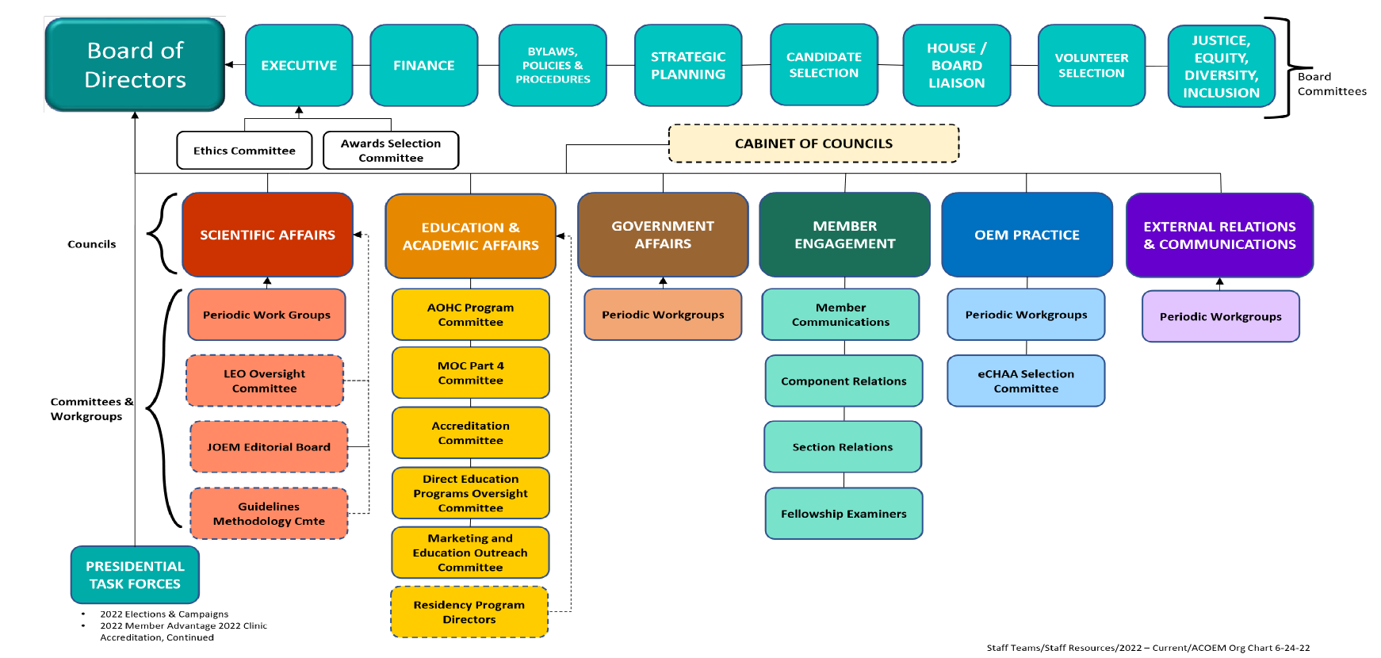
Governance Structure

Slide 22
Volunteer and Leadership Opportunities
Benefits: Professional growth, networking, betterment of specialty
In various areas:
Components
Sections
House of Delegates
Councils and Committees
ACOEM Ambassadors
Needed for advancement to Fellowship in the College
Apply via Community
https://community.acoem.org/participate/volunteeropportunities/opportunities-list-public

Slide 23
Components
Serve geographic regions
Independent entities
Some consolidation underway
Central States (Il, IN, WI, IA, MN, MO, ND)
Florida
Georgia
International
Kentucky
Metro Washington (DC)
Michigan
Mid-Atlantic (DE, MD, NJ, NY, PA)
Mid South (AL, AR, LA, MS)
New England (CT, ME, MA, VT, RI, NH)
Northwest (AK, ID, OR, WA, BC)
Oklahoma
Rocky Mountain (CO, MT, NM, WY)
Southeastern Atlantic (NC, SC, VA)
Tennessee
Texas
Tri-State (OH, WV)
Western (CA, AZ, NV, UT, HI)

Slide 24
Sections
History and Archives
International
Medical Center Occ Health
Medical Review Officers
Nurse Practitioners
Occupational Physicians/Physician Assistants
Pain and Musculoskeletal Medicine
Physicians in the Pharmaceutical Industry
Private Practice in Occupational Medicine
Public Safety Medicine
Residents and Recent Graduates
Transportation
Underserved Occupational Populations
Work Fitness and Disability
Based on member interests
Not independent – part of ACOEM
No actions without ACOEM approval
Academic
Behavioral Health
Corporate
Environmental Health
Federal and Military
Finances and Practice Management
Health and Human Performance
Health Informatics
https://acoem.org/Membership/Special-Interest-Sections

Slide 25
Councils and Committees
Carry out much volunteer work within ACOEM
Report to the Board and House of Delegates
Prepare statements and policies
Manage important functions including bylaws and ethics

Slide 26
House of Delegates
ACOEM’s legislative branch – since October 1966
Makes recommendations to Board of Directors on policy matters
Accept resolutions for discussion/vote twice yearly (spring/fall)
Representatives of components and sections (elected or appointed)
Sections of > 50 members plus Residents and Recent Graduates – 1 delegate
Component representation based on formula
7 Work Groups – Resemble councils
Internal Affairs/Bylaws/Policies/Procedures, Scientific Affairs, Education and Academic Affairs, Government Affairs, Membership, OEM Practice, External Relations and Communications
https://acoem.org/About-ACOEM/Governance/House-of-Delegates-en

Slide 27
Fellowship Requirements
3 years as Active Member (not student or resident member)
Board certified (one of three options)
OEM through ABPM
Non-OEM ABMS specialty (or international equivalent) + MPH + 50 hrs CME from ACOEM
Non-OEM ABMS specialty (or international equivalent) + 100 hrs CME from ACOEM
Application
One-page narrative outlining contribution to ACOEM, components, or field of OEM
Two letters of recommendation (one from ACOEM Fellow)
Current CV
$225 application fee

Slide 28
Questions and Discussion

